Slide 1

Retrofitting a Conventional Ender 5 3D Printer to Incorporate Multifunctional 3D Printing Technology and Printed Electronics
Presented by: Abhay Chhabra
Supervisor: Dr. Simon S. Park Micro Engineering, Dynamics and Automation Lab (MEDAL)
Dept. of Mechanical & Manufacturing Engineering
Schulich School of Engineering at the University of Calgary
August 13, 2021

Slide 2
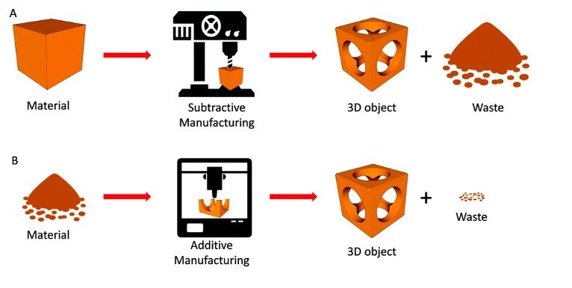
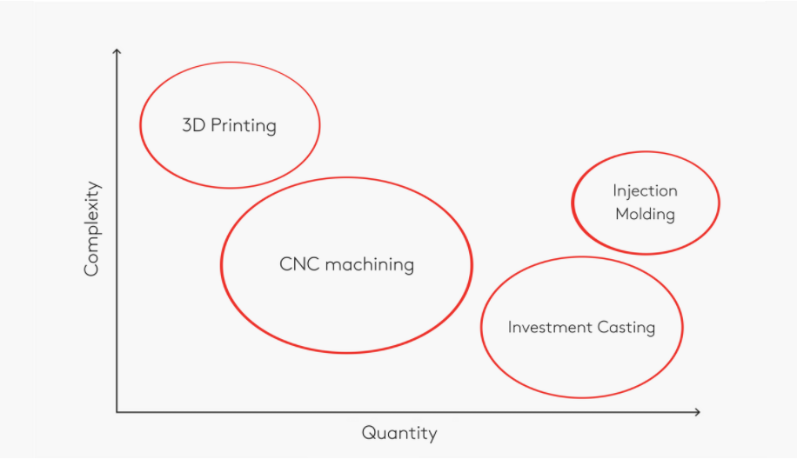
Background- Additive Manufacturing
3D printing reduces material waste by depositing material layer by layer
To manufacture few and highly complex parts, choosing additive manufacturing will help you save costs, prototype faster and therefore earlier and cheaper in the market.
[1]

Slide 3
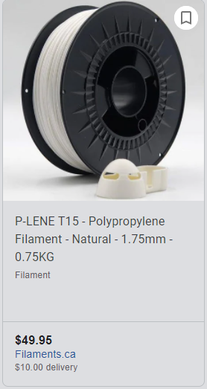
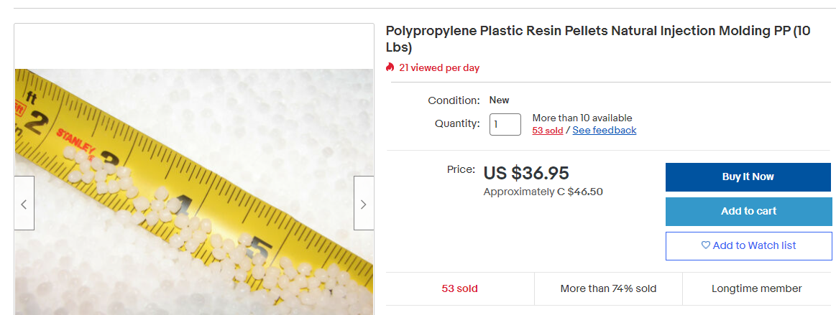
Background- Pellets vs Filament
Resin comes in pellet form from the manufacturer
Converting it to a filament is a secondary process which increases the cost of filament
Different polymers require different preparation techniques which also increases the cost of filament
[2]

Slide 4
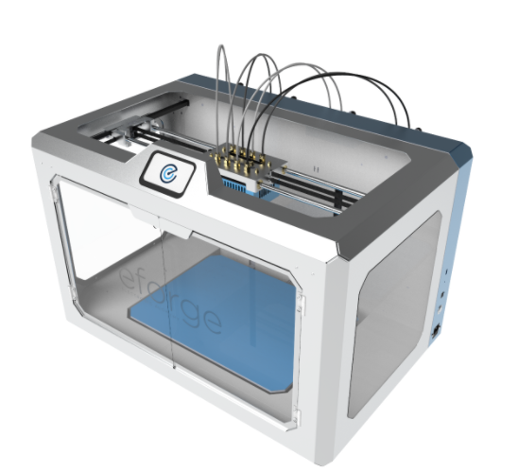
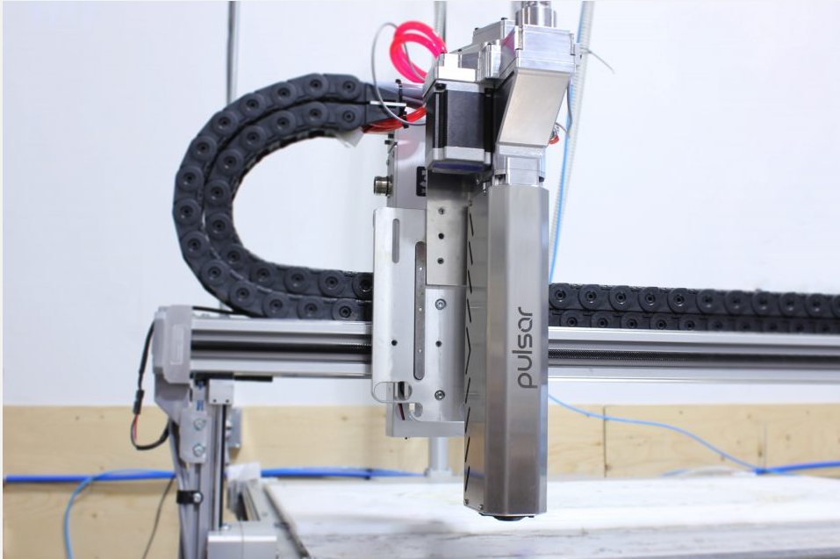
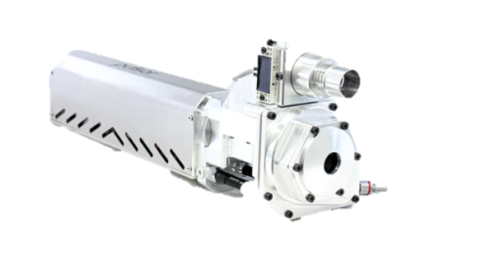
Objectives and Market Examples
The objective of this retrofitted printer is to use a pellet extruder and print objects made of conductive materials and eventually print sensors and communication devices all in one process
Pulsar pellet extruder
E forge multi-material electronics printer
[3]
[4]

Slide 5
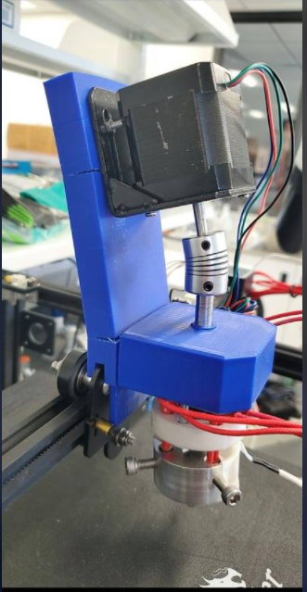
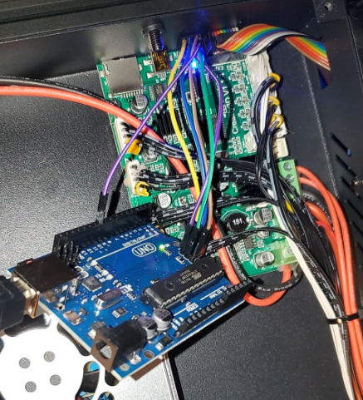
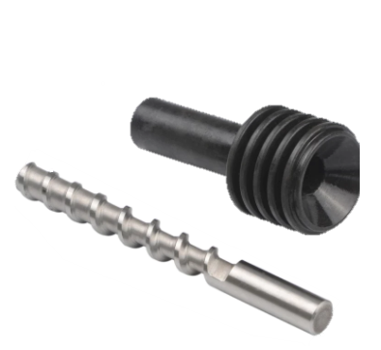
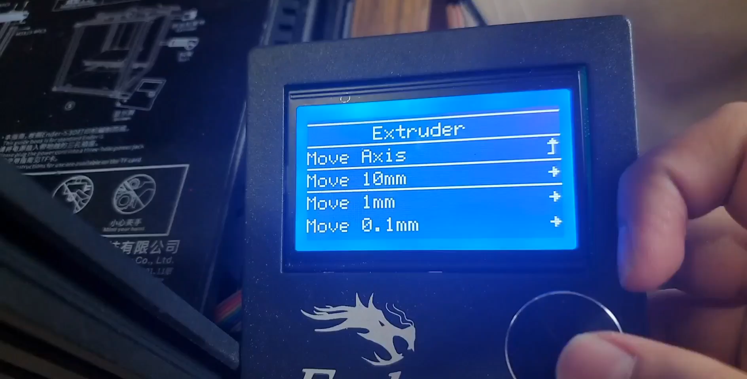
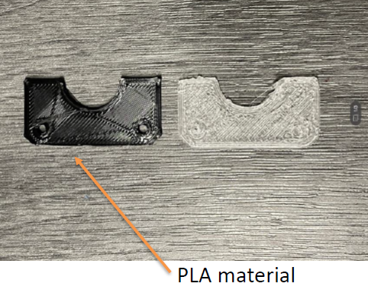
Retrofitting 3D Printer- Initial Stages
Initial progress and extruder setup
Updating Marlin Firmware to fix motor issues
PID autotuning for temperature stabilization
Changing temperature thresholds to allow motor
rotation at desired melting points
Initial Extruder setup and prints

Slide 6
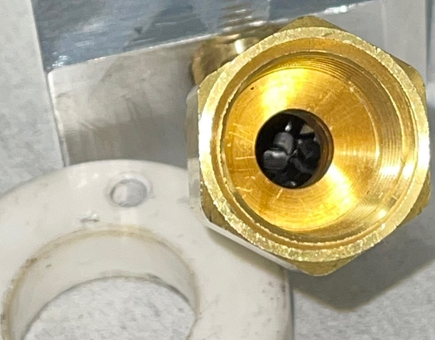
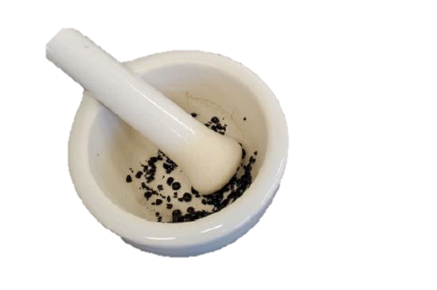
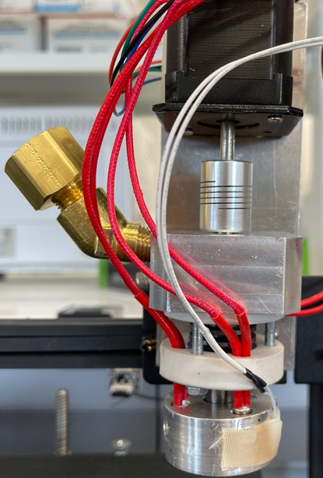
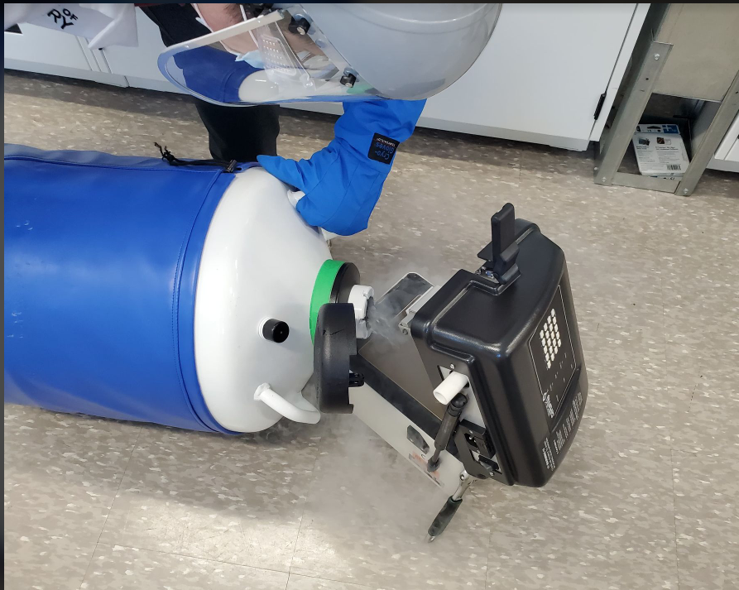
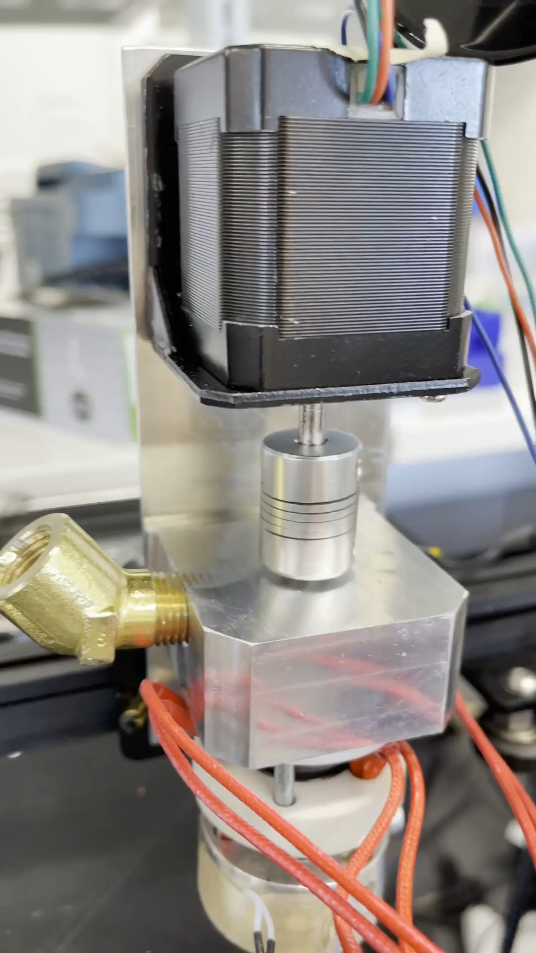
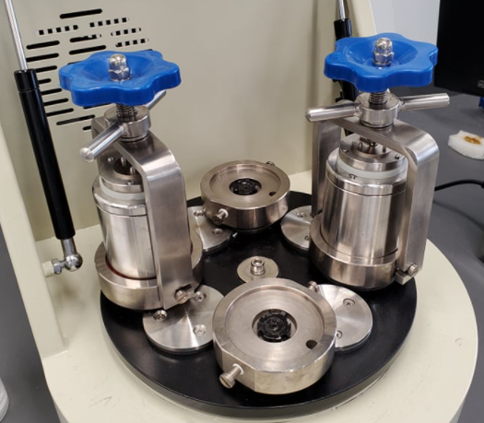
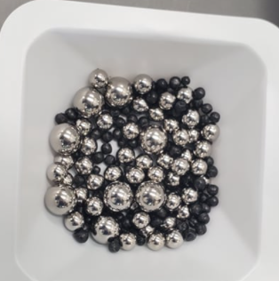
Retrofitting 3D Printer- Changes From Plastic Parts to Aluminium and Brass
1) Mortar and pestle crushing
2) Freezer mill
All metal extruder setup
Extruder would skip steps due to relatively weak extruder screw and motor
3) Ball mill after cryogenic bath of pellets

Slide 7
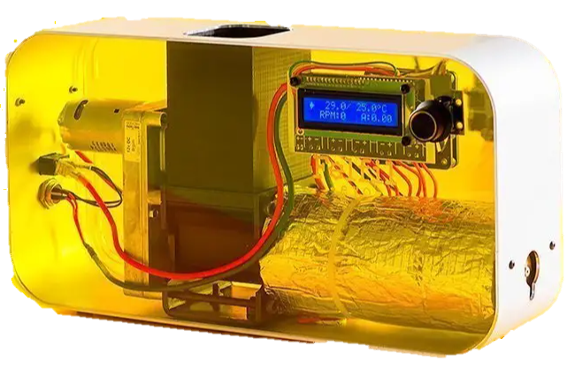
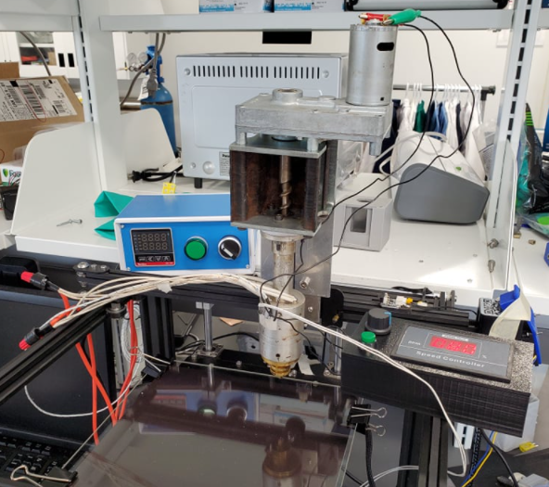
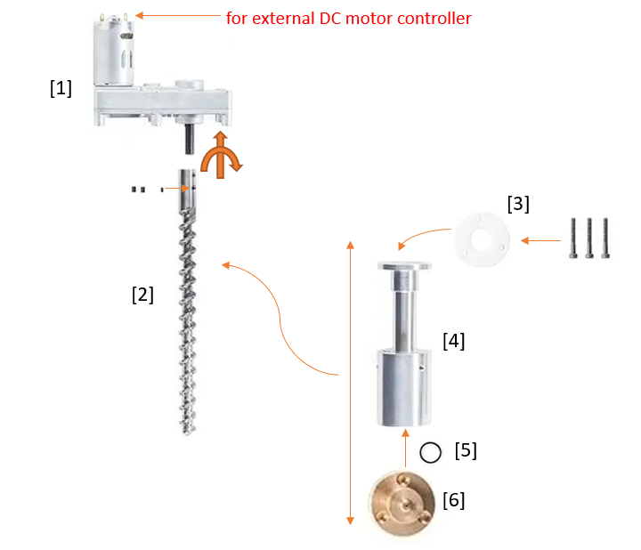
Retrofitting 3D printer- Using Feflil extruder
Felfil filament extrusion system
Final setup consisting of the mounted felfil extruder, external DC motor controller and external temperature controller with heater blocks

Slide 8
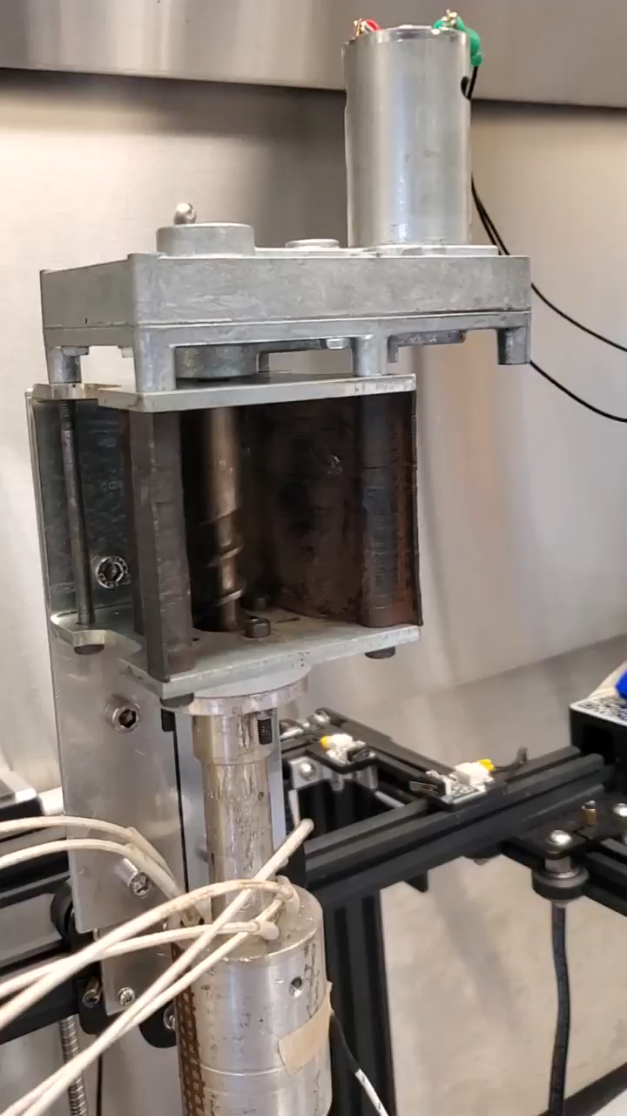
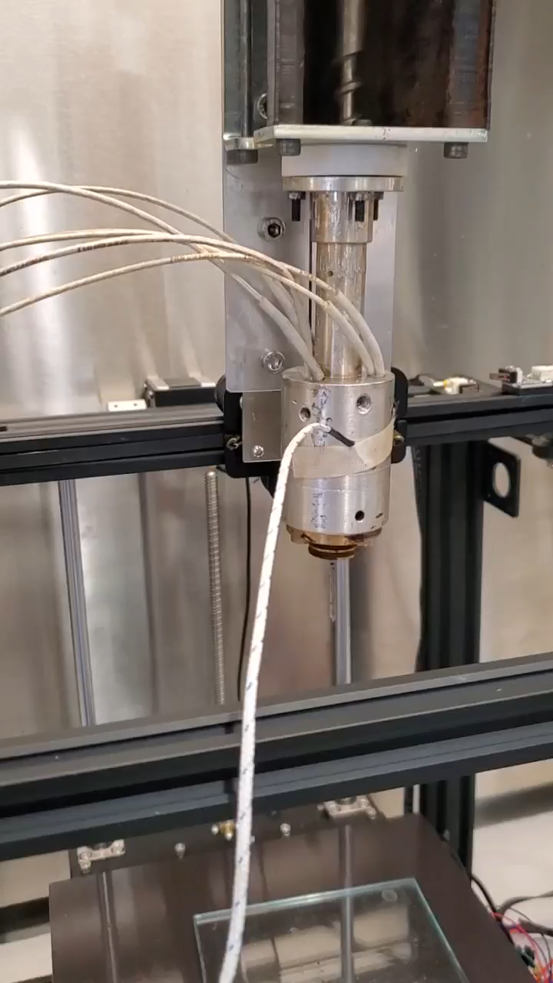
Extrusion of Pellets using Felfil Extruder
Extrusion of graphene infused polycarbonate pellets
Extrusion of PE pellets

Slide 9
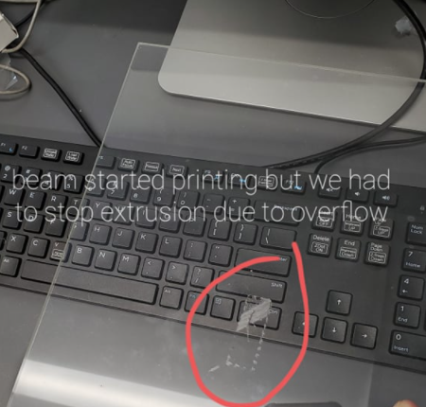
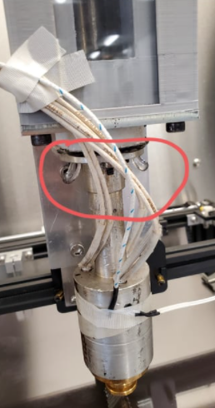
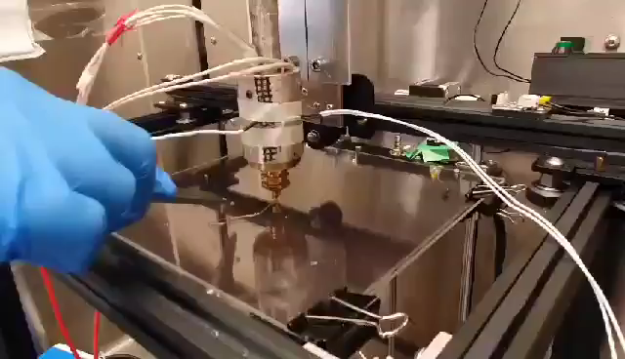
Current Works
PE overflow from cylindrical block

Slide 10
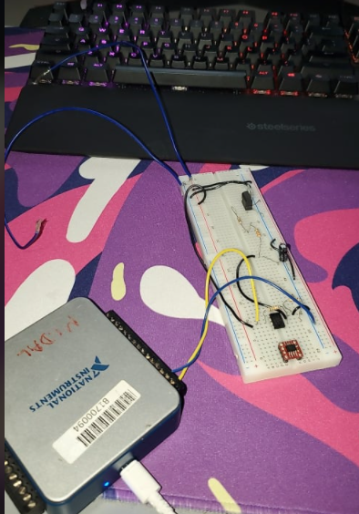
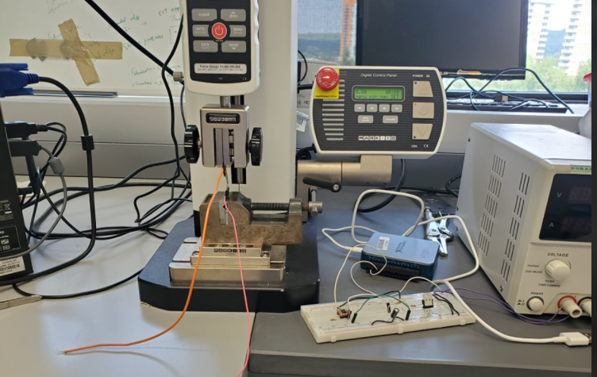
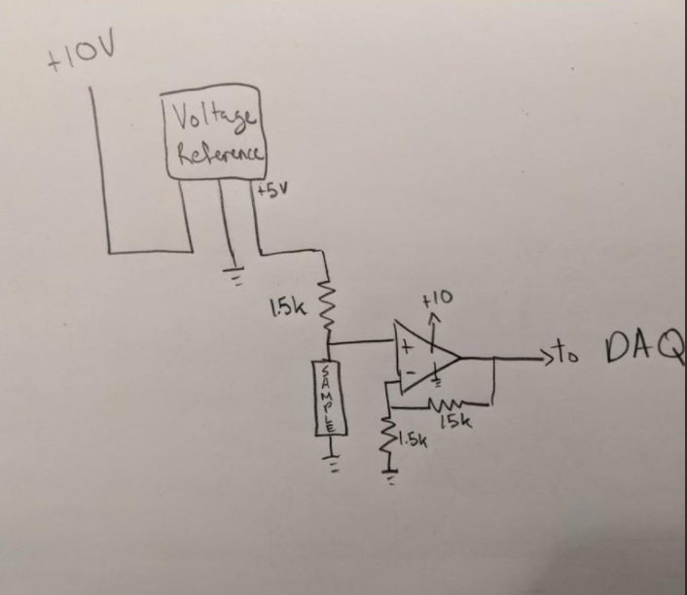
Future Plans and Voltage Drop Circuit
Updated breadboard circuit consisting of extra capacitors to
construct a low pass filter to reduce noise for the DAQ
Testing setup
Circuit schematic by previous intern
Want to use this voltage drop circuit to measure live changes in resistance from conductive objects printed using the pellet extruder

Slide 11
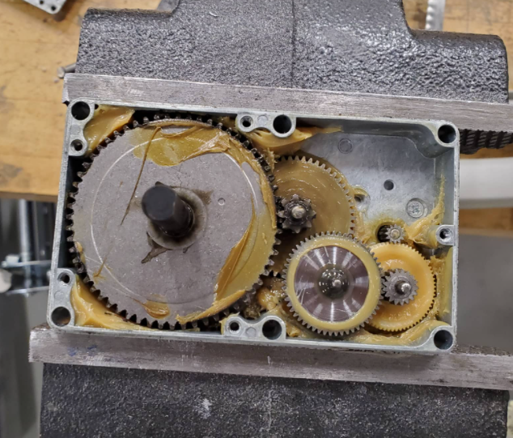
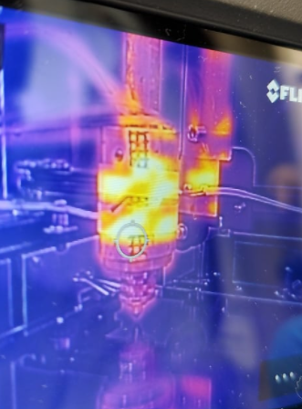
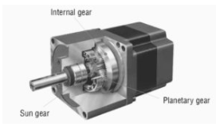
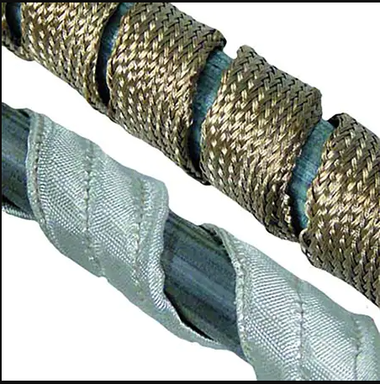
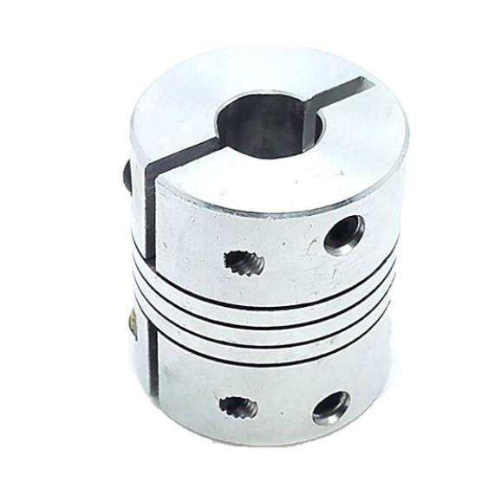
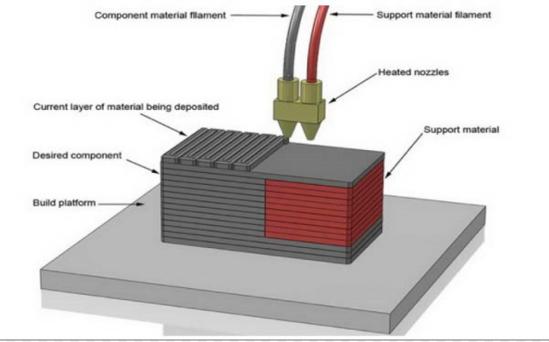
Future Works
Currently the printer has a DC motor with a gearbox, eventually want to replace this with
a gearbox stepper motor and coupler setup like the previous extruder models for 3D printing
IR image of the cylinder during extrusion, uneven heat zones due to convection and conduction since heat is not uniformly applied
Eventually have a dual nozzle system printing conductive inks and other polymers

Slide 12

Thank you for your time!

Slide 13
References
[1] https://bitfab.io/blog/additive-manufacturing/
[2] https://www.ebay.ca/itm/184419446964?chn=ps&mkevt=1&mkcid=28
[3] https://all3dp.com/4/dyze-designs-pulsar-pellet-extruder/
[4] https://www.electronicalchemy.com/eforge/

